Slide 1
BlueFi: Bluetooth over Wi-fi
Paper by Hsun-Wei Cho and Kang G. Shin
Group member:
Nikhila Kunku, Fatema Tabassum Liza, Phat Tran

Slide 2
BlueFi
BlueFi- a novel system that enables the transmission of BT signals using 802.11n-compliant hardware with simple driver updates

Slide 3
Motivation
Bluetooth is widely used with multiple purpose such as sending location beacons for navigation and personal audio streaming.
Without Bluetooth transmitters, can we still use Bluetooth devices? NO
Without Bluetooth transmitters, there are still many Wi-Fi devices that have been installed such as Wi-Fi access points, desktop and laptops with Wi-Fi chips, USB Wi-Fi cards.
BlueFi enables WiFi hardware to transmit Bluetooth signals with driver updates and no modification for the Bluetooth devices.

Slide 4
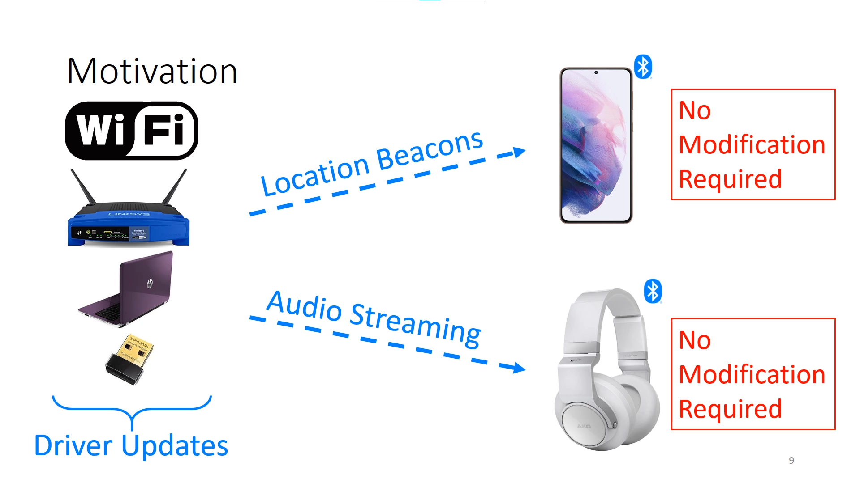
Motivation

Slide 5
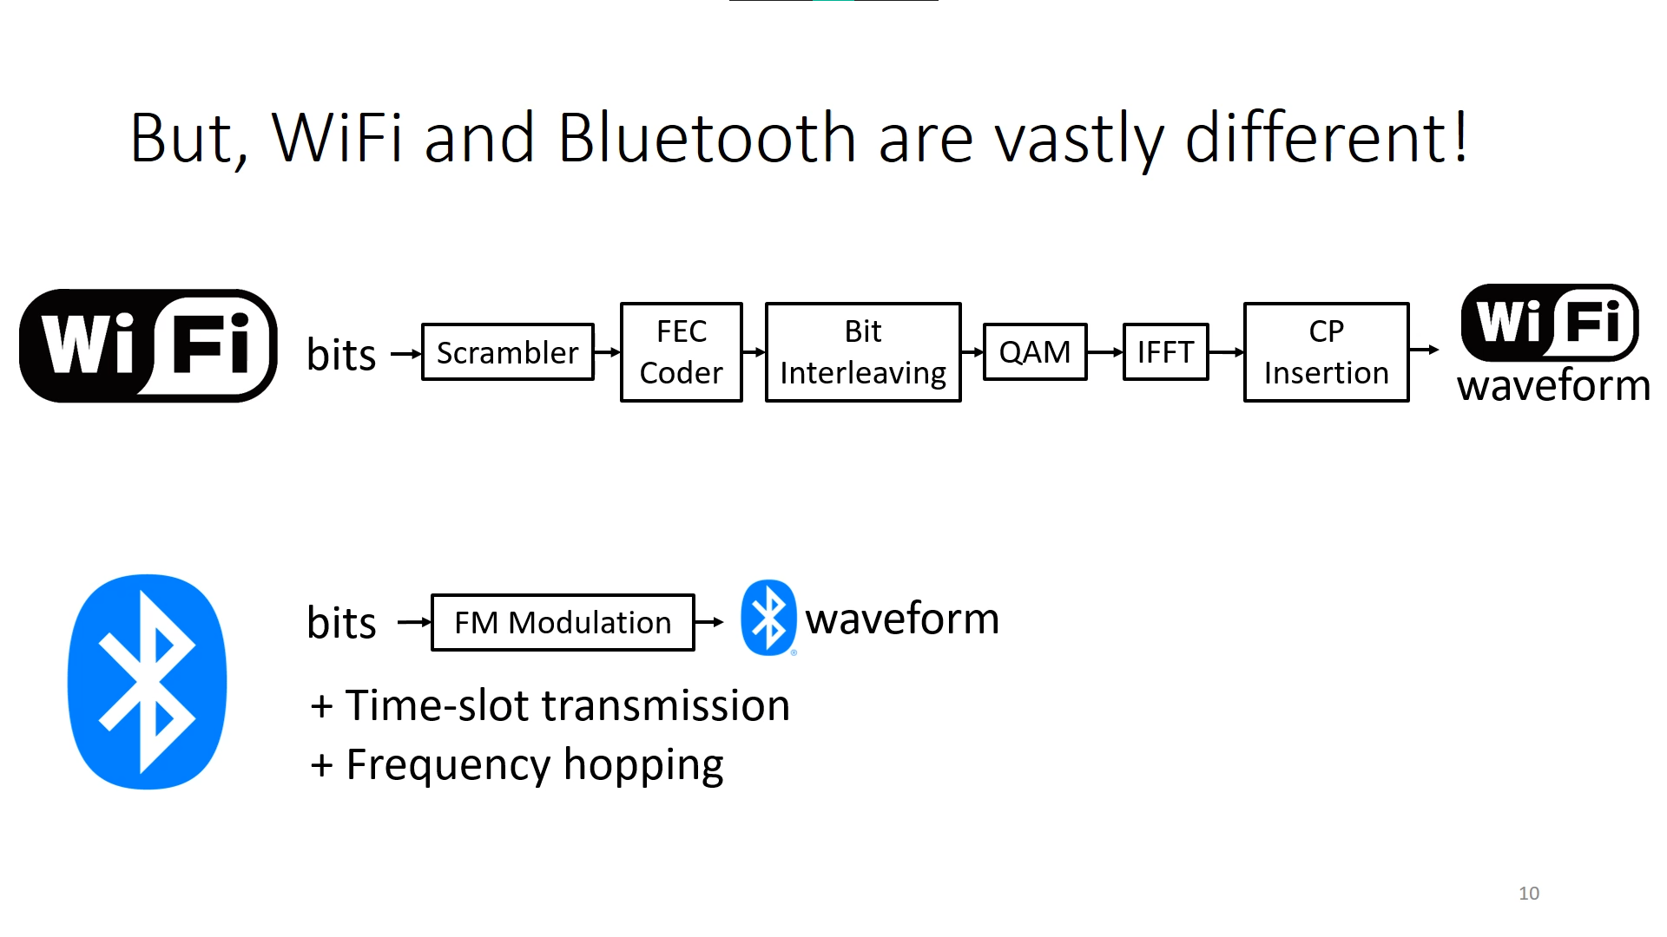
Challenges
Bluetooth and Wi-Fi signals are different. At the highest level, Bluetooth encodes the information in the time domain whereas Wi-Fi uses OFDM and encodes the information in the frequency domain.

Slide 6
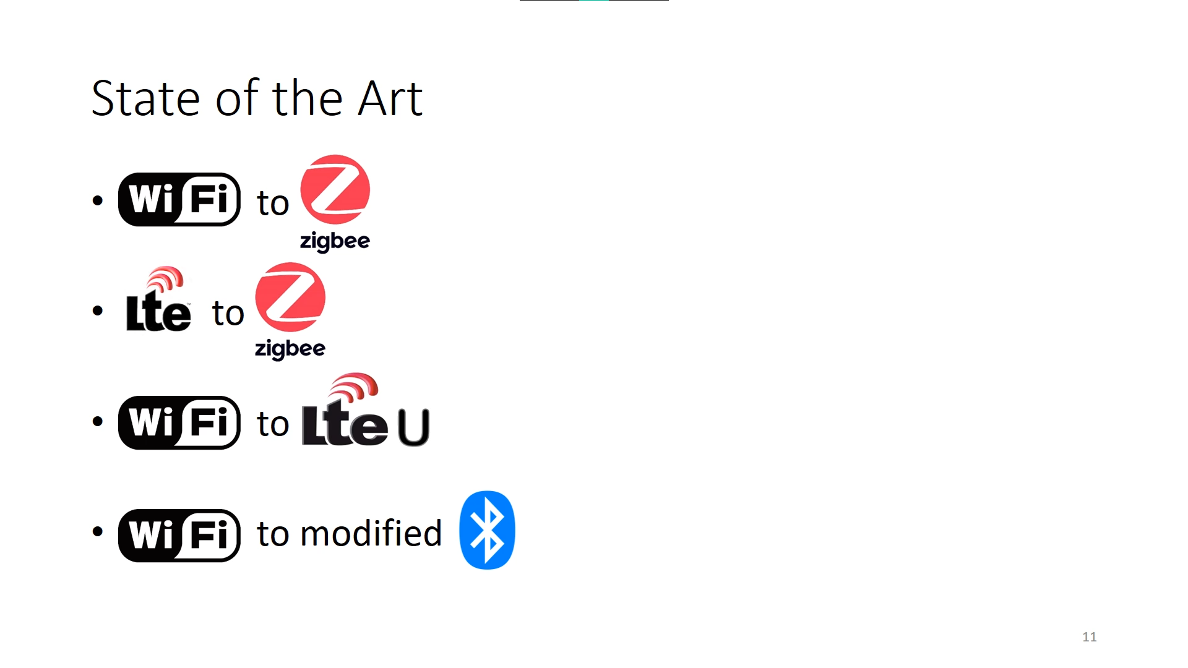

Slide 7
State of the Art
Mostly focus on Zigbee but Bluetooth does not have Zigbee error correction and transmit bits faster.
Cisco Virtual Beacon adds the Bluetooth functionality to existing Cisco APs.
Cisco needs dedicated hardware on every AP
Require hardware and deployment costs
BlueFi is unique in that:
Unmodified Bluetooth devices
commercial off-the-shelf (COTS) Wi-fi chips are used
Broadcasting and general Bluetooth applications
Real-time processing has been tested

Slide 8
Main idea
If the transmitted waveform look like a Bluetooth waveform, common Bluetooth devices can decode the signal.
Therefore, if we can find the Wi-Fi bits given a Bluetooth waveform, then when we want to transmit a Bluetooth signal, we can find the corresponding Wi-Fi bits and transmit them with Wi-Fi hardware.
In order to this, we try to reverse the operation of each block in the transmitter.
However, each blocks have different challenges to reverse the operation.
4 main challenges:
Cyclic prefix insertion
QAM
Pilots and Nulls
FEC Coder

Slide 9
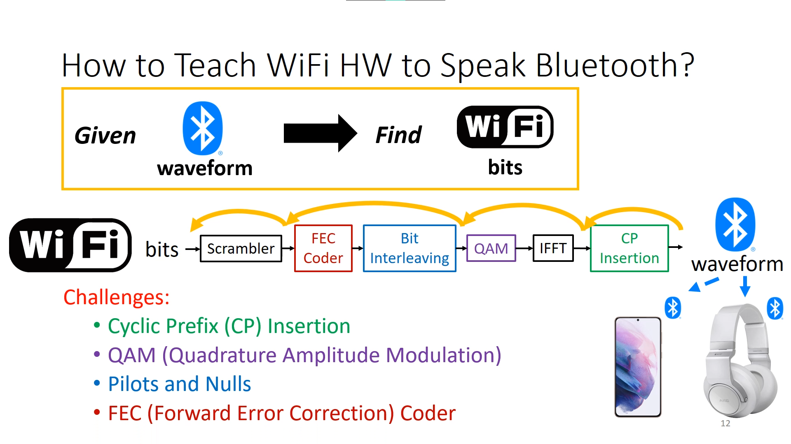

Slide 10
Main Challenges
Cyclic Prefix insertion
OFDM systems use CP to overcome ISI. However, small portion of Bluetooth waveform will be overridden by this CP insertion.
QAM Modulation
OFDM encodes the information in the frequency domain before IFFT. Selecting the optimal constellations for Bluetooth performance is IP(Integer-programming) problem and hence NP-complete.
Pilots and Null
Pilots and Nulls will corrupt the transmission waveform if they are too close to the center frequency of Bluetooth channel.
FEC Coder
Adds redundancy to bit-stream. So need to find bits which are more important than others.

Slide 11
CP Insertion
For Wi-Fi which use OFDM, cyclic prefix is used to mitigate inter-symbol interference.
To use CP insertion, Wi-Fi copy the tail and put it in the front of the symbol. Then, it employs symbol windowing by extending 1 sample for the symbol and average overlapped samples

Slide 12
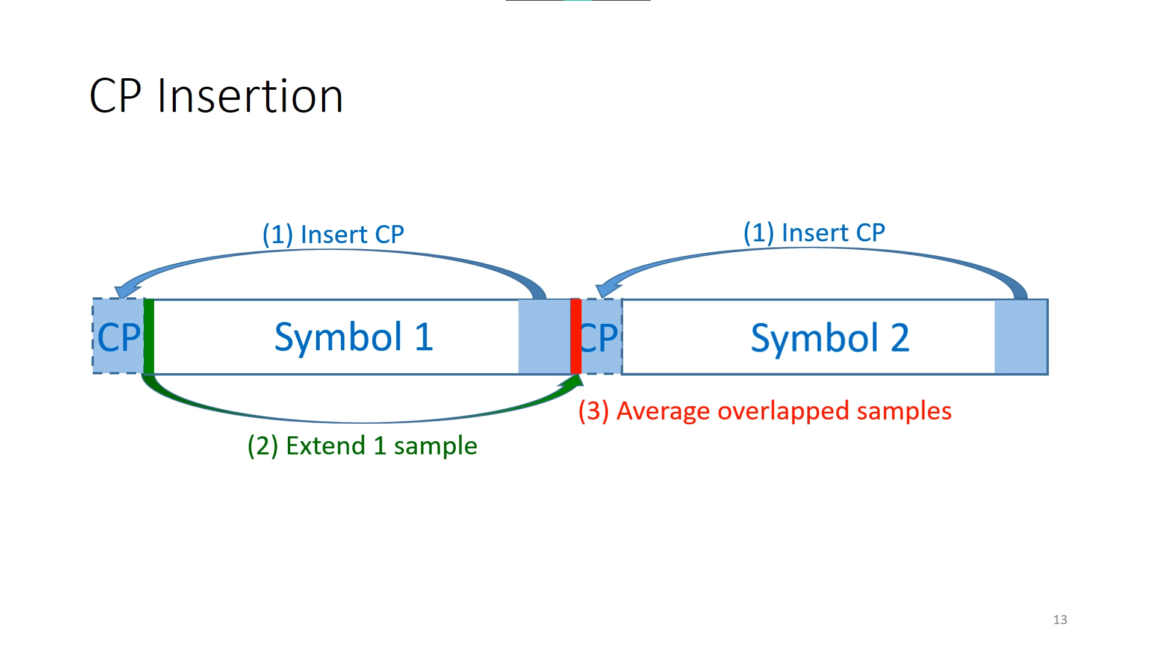

Slide 13
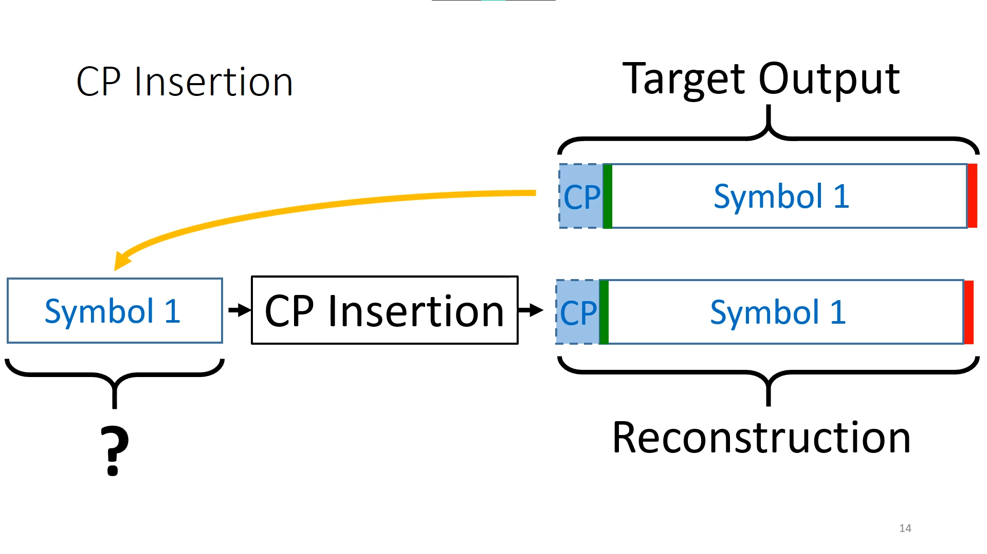

Slide 14
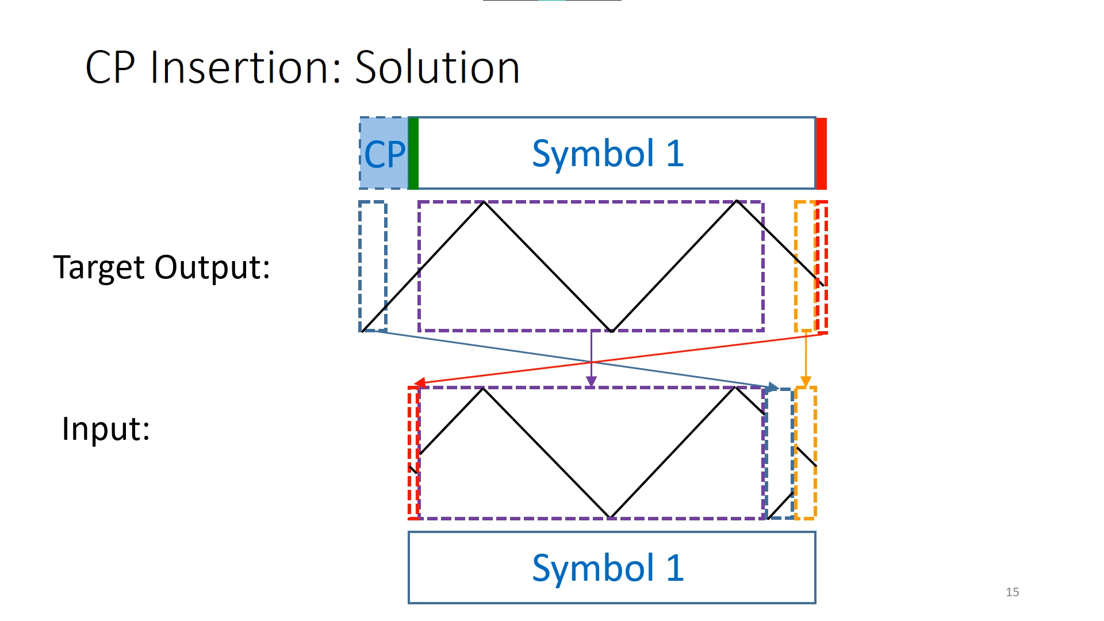

Slide 15
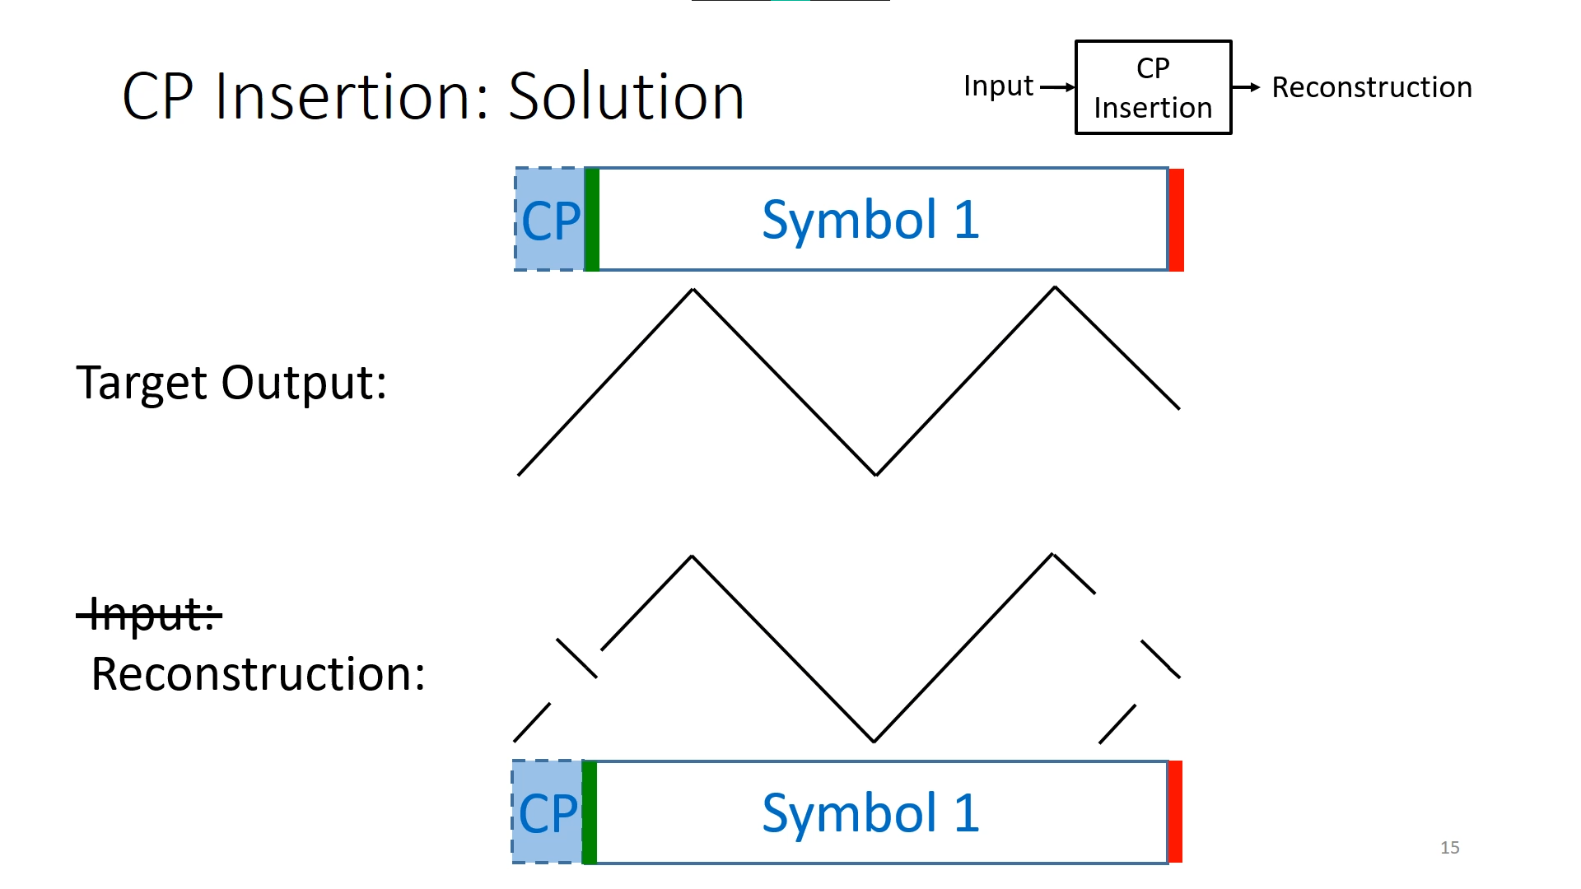

Slide 16
QAM
The CP insertion block is immediately preceded by IFFT and QAM generator. Therefore, BlueFi first applies FFT to the reconstructed input to the CP block to obtain the frequency-domain samples that the QAM generator should generate.
Then, for any given X[f], set Xˆ[f] to the constellation with the shortest Euclidean distance.

Slide 17
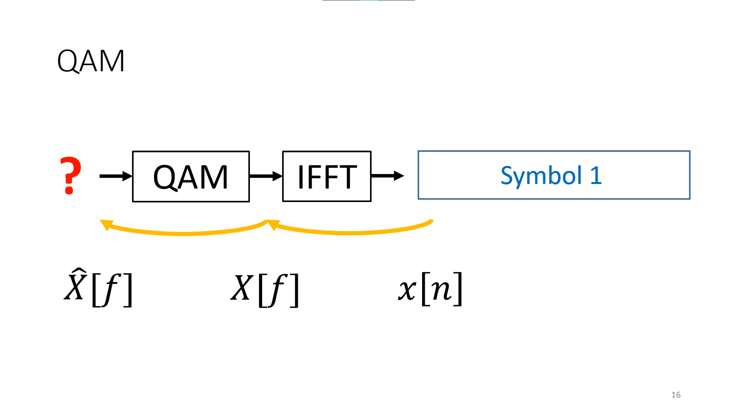

Slide 18
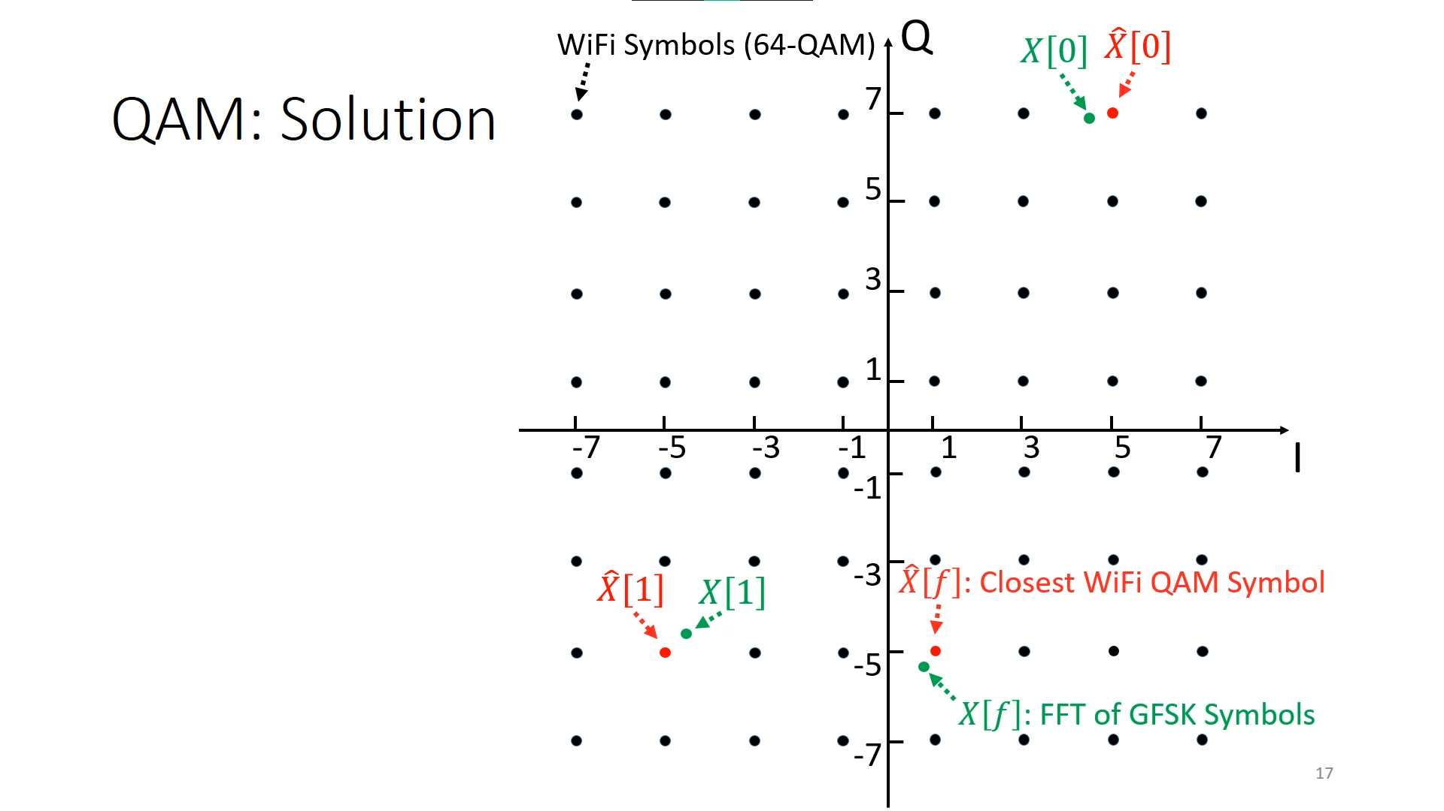
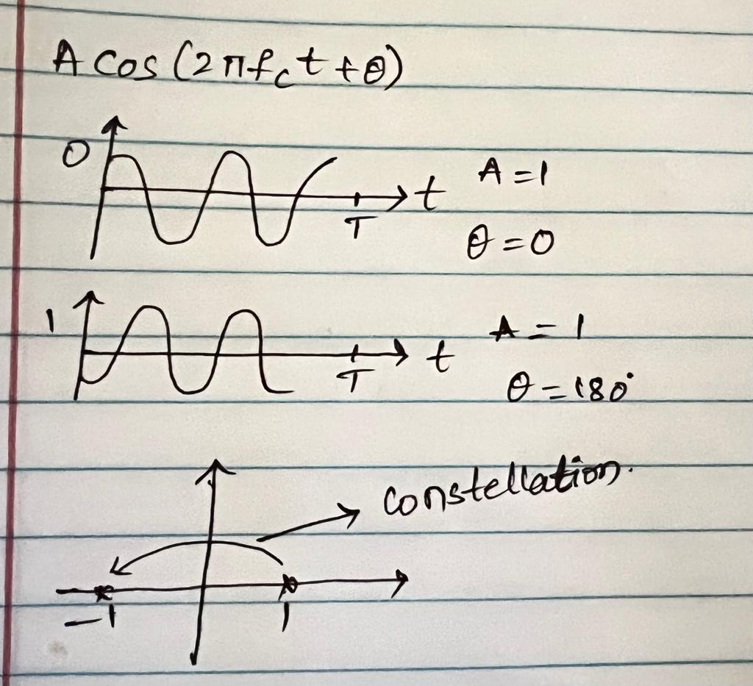
For BPSK

Slide 19
Pilots and Nulls
Since some subcarriers are not modulated by the incoming data such as pilot subcarriers which are modulated by known sequences and null subcarriers which are always 0, we cannot control these subcarriers.
To solve the problem, we use frequency planning in which we can switch Wi-Fi channels by choosing the one that keep the Bluetooth channel farthest away from pilots or nulls.

Slide 20
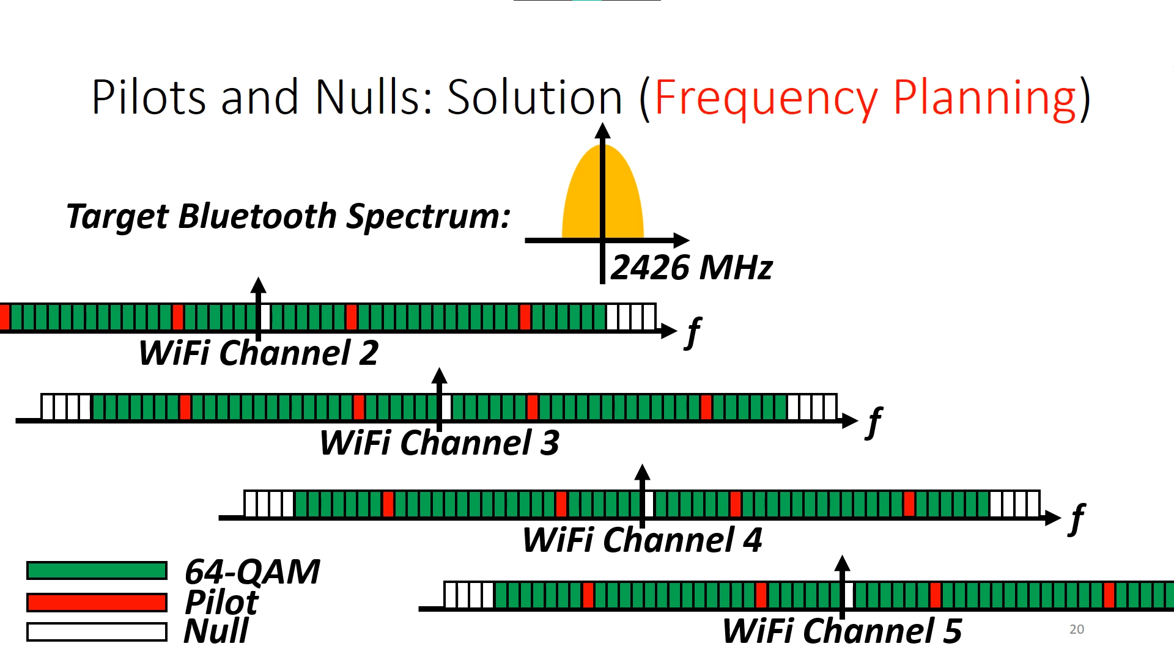

Slide 21
FEC Coder
Solution #1: Viterbi Algorithm modified with weights because some bit's location are more important than others. The reason is because bits on the main Bluetooth spectrum need as few bit flips as possible while the bits on other subcarriers do not matter.
Solution #2: Look-up Tables with Partial Match. Dues to the well-designed Wi-Fi codebook, we can find a 1 to 1 mapping from the part output sequence to the input sequence which can guarantee no bit flips at the matching location. It is efficient in real-time situation due to the computational efficiency of look-up table.

Slide 22
Additional Designs
Scheduling signal transmission with high resolution timers to align with Bluetooth timeslots.
Frequency hopping by using different subcarriers.
Using multi-slot transmission to push throughput.

Slide 23
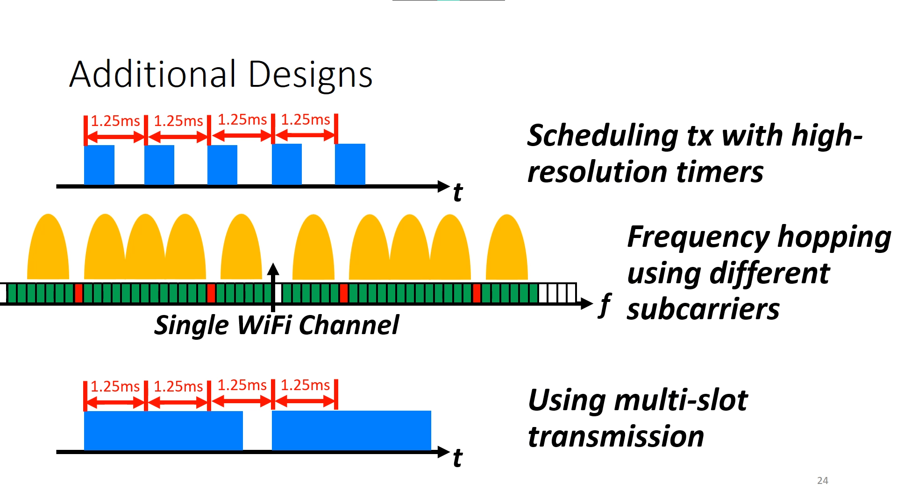

Slide 24
Experiment
Equipment:
An iPhone, a Google Pixel and a Samsung S6 (Edge) as Bluetooth receivers.
The nRF Connect app on the iPhone and the Beacon Scanner app on Android devices.
The GL-AR150 Wi-Fi router, with an (Qualcomm) Atheros AR9331 chip.
The TP-Link T2U Nano WiFi NIC, with the RTL8811AU chip from Realtek
Sony SBH20 Bluetooth headphones
FTS4BT Bluetooth protocol analyzer

Slide 25
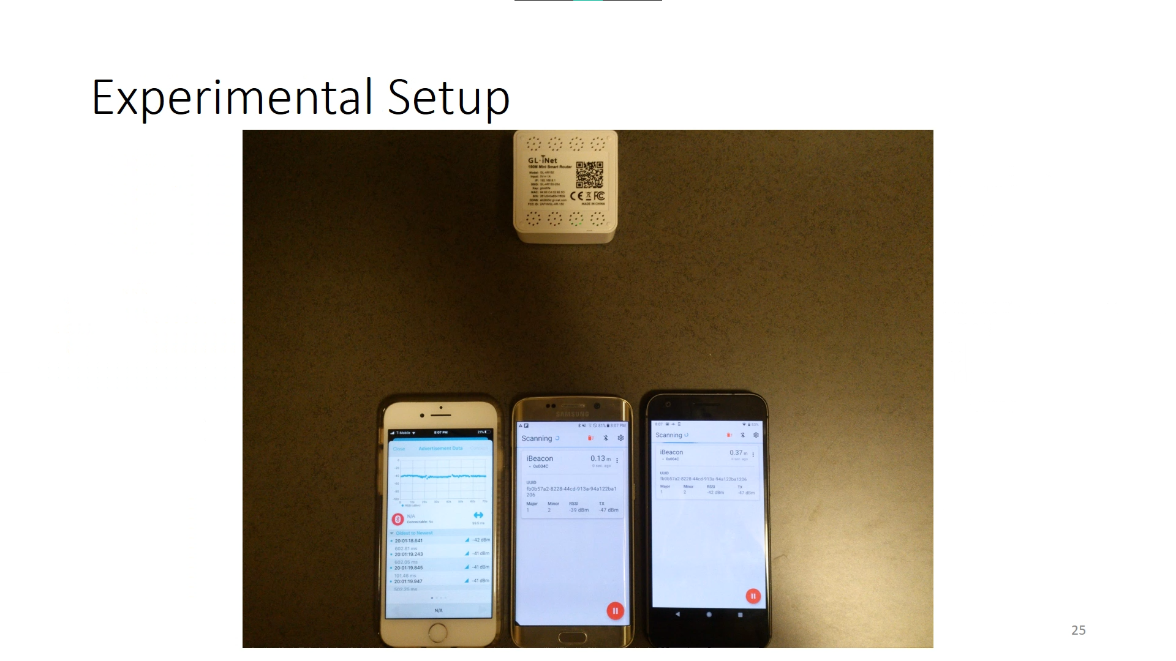

Slide 26
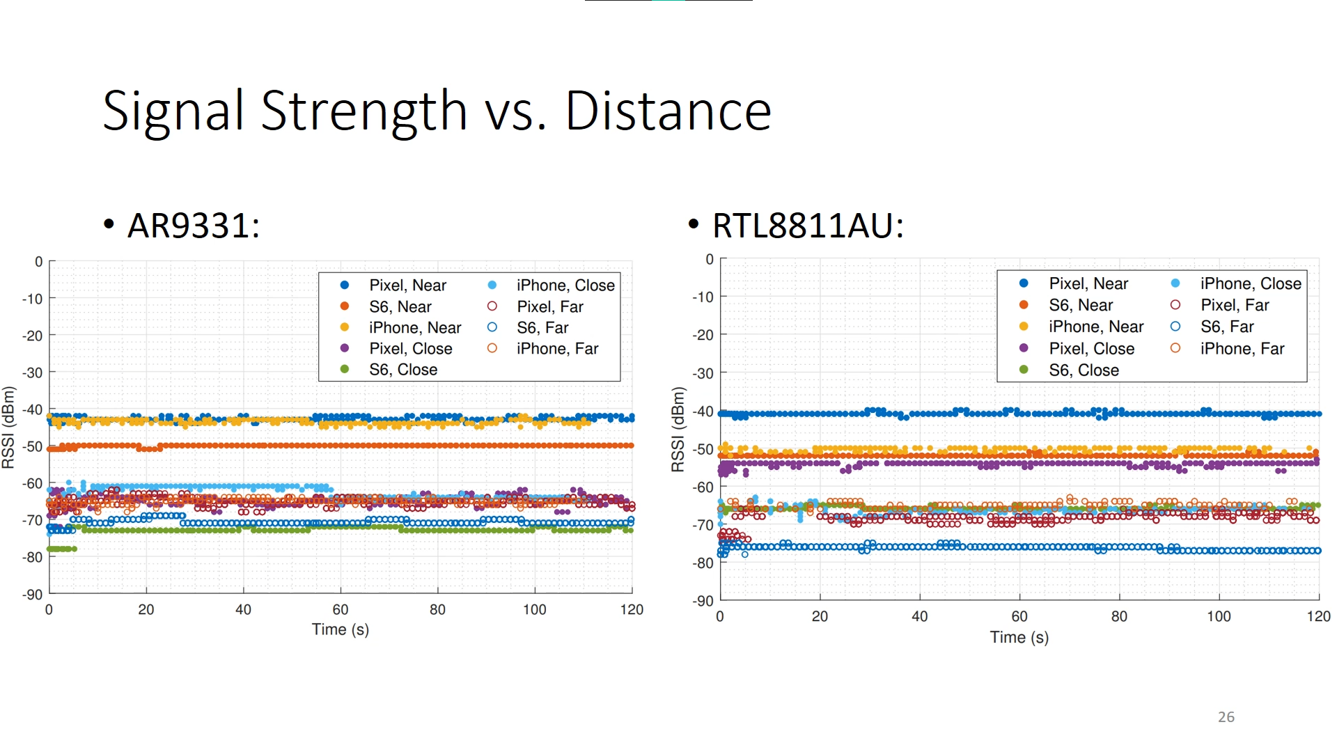

Slide 27
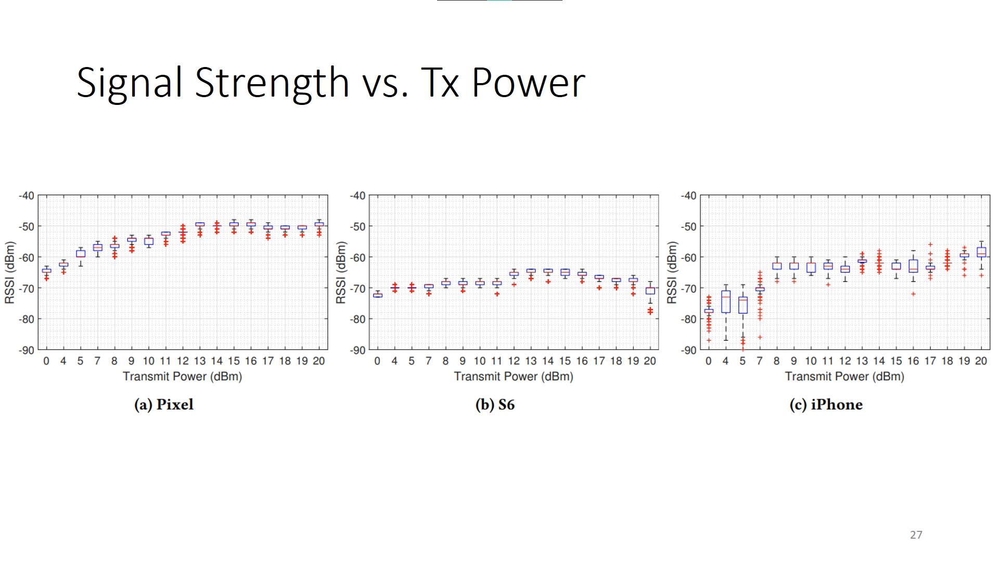

Slide 28
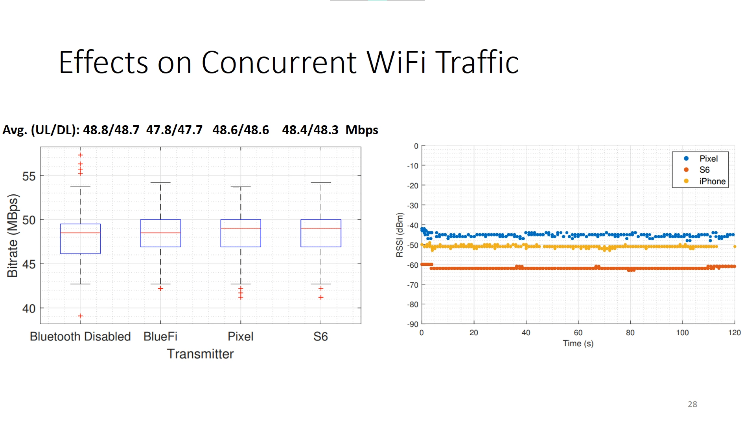

Slide 29
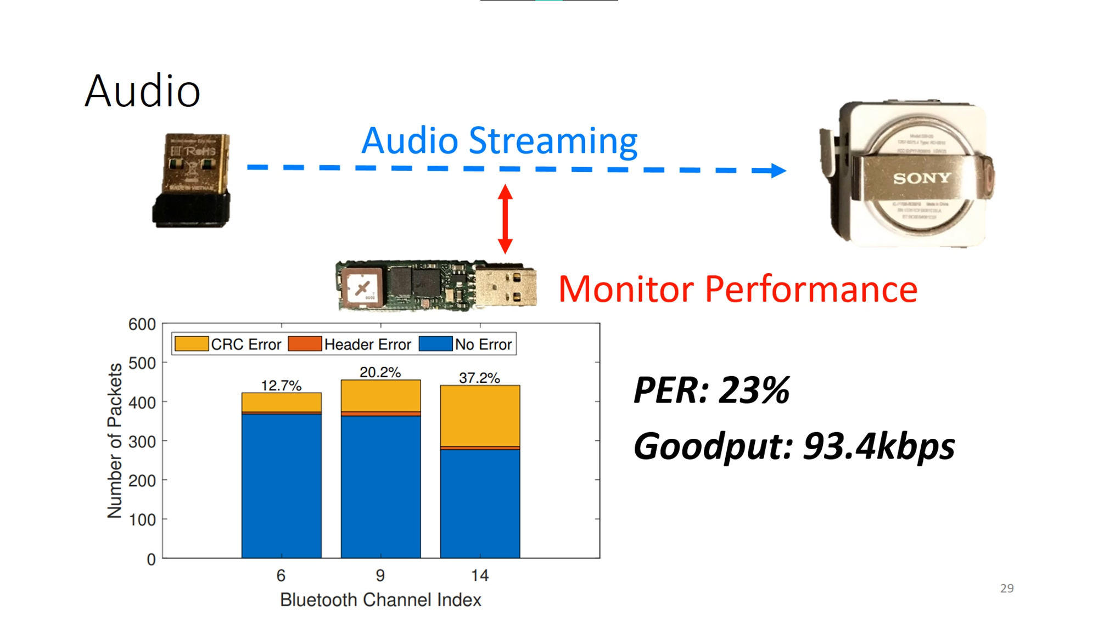

Slide 30
